Slide 1
Smart Team working
We would love to tell what are the roles, our best processes and the possible tools you will use to work effectively in team
Notes:
Lavoro di team per migliorare lo sviluppo del software DNN
Ci piacerebbe raccontare quali sono i ruoli, il processo ideale e i possibili strumenti che si possono utilizzare per lavorare con efficacia in un gruppo

Slide 2
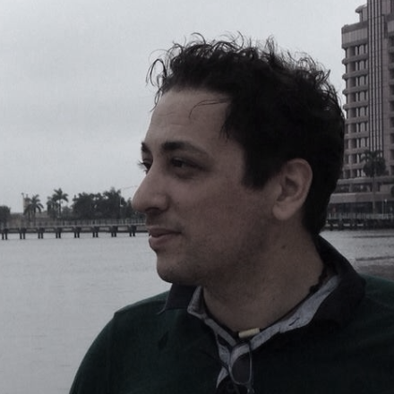
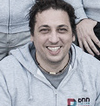
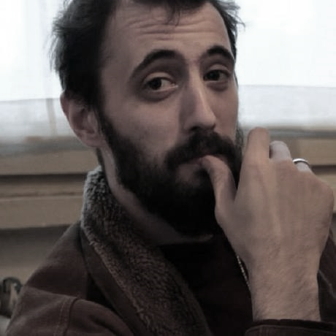
Presentation
Matteo Benedusi
(Project Manager and Analyst)
In the market since 2002, Opsi srl (www.opsi.it) is a software company that combines experience and technology to meet your business goals, walk you through the process of creating websites and web applications. Since 2012 Opsi has been the only Italian company certified as a DNN Gold Partner. In addition, we manage the DNN Italian Community and are instrumental to DNN’s development team.
Matteo e Paolo work together in teams on major OPSI’s enterprise customers. Matteo is Project Manager and analyst, Paolo is front-end developer.
Paolo Roth (Front-end developer)

Slide 3
Who can take value from this presentation
How can I improve my project quality and workflow?
How can I make enterprise projects?
Developer
Project Manager
Software architect

Slide 4
What do I need to improve?
I want a successful enterprise project
Customer satisfaction
Best user experience interface
Fast development
Easy maintainance

Slide 5
How can I do it?
You need
new ingredients

Slide 6
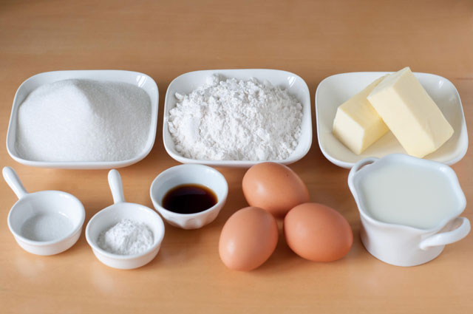
Why are we talking about ingredients?
What kind of ingredients do I need?
What kind of recipe do I need?
Recipe
Step by step
ingredients
cake
Wow I have my cake!
Notes:
Qule

Slide 7
Focus on new ingredients
New ingredients
Teamwork
Basic ingredients
DNN
Methodology Project 7 steps +
Module 6 steps
.NET
Tools
Balsamiq – office lens
sublime – powerpoint
Word – pdf - trello
SQL server
Visual studio
Technology
angularJS
nodeJS

Slide 8
Teamwork
1° Ingredient: working in a team

Slide 9
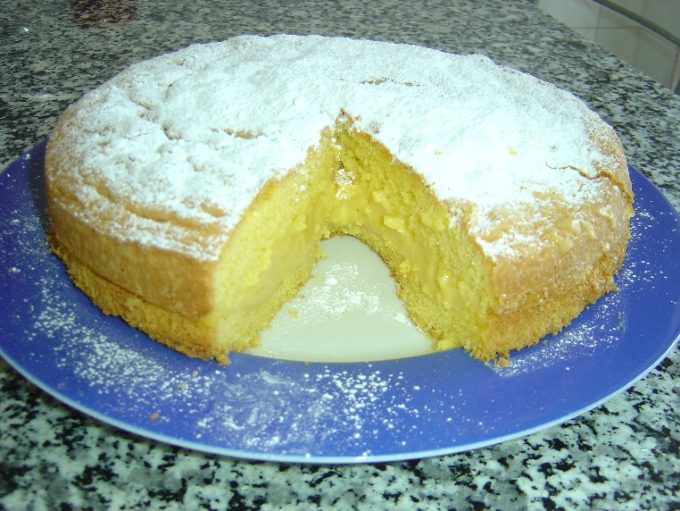
Project made by myself VS Teamwork
project made by myself
Teamwork

Slide 10
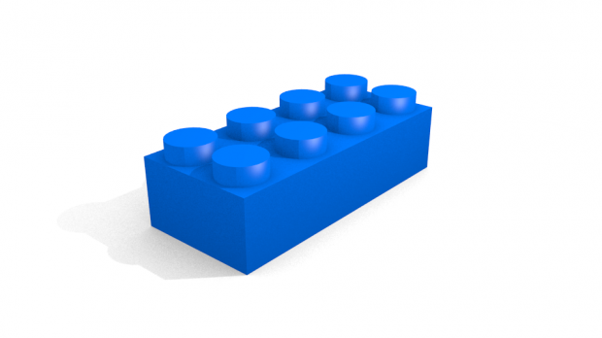
Teamwork: why a Team leads to a successful project
Module is like a piece of Lego
A project needs one or more modules
To build a house you need a Team

Slide 11
Teamwork: 6 basic roles
Project Manager
Analyst
Graphic designer
Web designer
Web developer
Database architect
6 basic roles

Slide 12
Teamwork
Do we really need six people to develop a successful project?
The right answer is: maybe….depends on project requirements.
Most «smart team» projects need at least 3 smart people

Slide 13
Teamwork: benefits to work in a Smart Team
Team benefits
Team member benefits
Sharing technical experiences
Sharing ideas
Sharing thoughts
Higher productivity
Power of brainstorming to solve problems
Working smarter not harder
Less difficulty finding solutions
Having defined and measurable objectives is useful to set timing and deadline
Higher productivity
Reuse most of their experience
people grow faster

Slide 14
Methodology
2° Ingredient:
Methodology
Seven steps for the development team smart project
6
7
5
4
3
2
1
Notes:
The goal is always your project, keep in your mind.
1. Now you have understood why is important to have a team
2. Now, you need a Methodology

Slide 15
The seven steps for the development team smart project
Team
Your project by 7 steps
1
2
3
4
5
6
7
Function analysis
Wireframe
Technical analysis
with your team
Module development
Test
and
bug fixing
Assembly (all pieces together)
Share the analysis and
Wireframe with your team
Mockup (Graphic design)
Notes:
Why is important to share a project.
It’s important to show borders of your project.
Abbiamo bisogno di capire per ogni step:
Obiettivo:
Responsabile:
Strumenti utilizzati:
Come condividere:

Slide 16
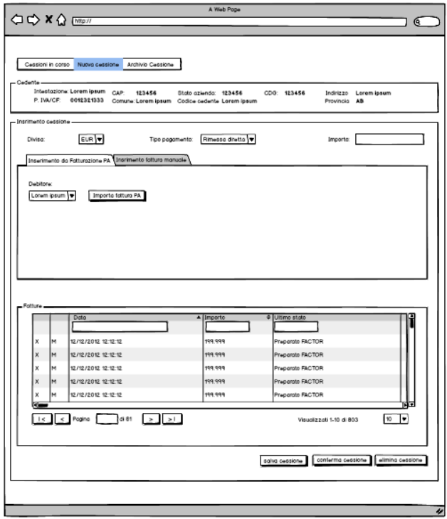
Project step 1: Function analysis and wireframe
1
2
3
4
5
6
7
What are my expectations? | Who is responsible? | How can I achieve it? | What can help me? (3° and 4° ingredients tools and technologies)
From customer’s idea to paper. Make a small document .doc | Analyst | Understanding customer needs
From document to sketch-style wireframes | Analyst | Sharing our «first» ideas with the customer and getting feedback.

Slide 17
Project step 2: Share analysis and wireframe with team
1
2
3
4
5
6
7
What are my expectations? | Who is responsible? | How can I achieve it? | What can help me? (3° and 4° ingredients tools and technologies)
To figure out if analysis doc and wireframe are understandable. To understand if you have the right team. | Project manager, Analyst | Sharing project informations and discussing with the team.
Notes:
Dire i benefici

Slide 18
Now 10 seconds of meditation
Team now can understand customer’s project
Team can be propositive and now each person in a team can be a «solving problem man»

Slide 19
Project step 3: Team Technical analysis
1
2
3
4
5
6
7
What are my expectations? | Who is responsible? | How can I achieve it? | What can help me? (3° and 4° ingredients tools and technologies)
To improve wireframes (show result to customer) To make visual technical documentation (UML) To organize a list of tasks |  | Meeting with the team: sharing technical ideas, sharing technical problems, sharing smart solutions.
All team
Notes:
Obiettivo
Responsabile
Team Technical analysis
Strumenti utilizzati
Condivisione

Slide 20
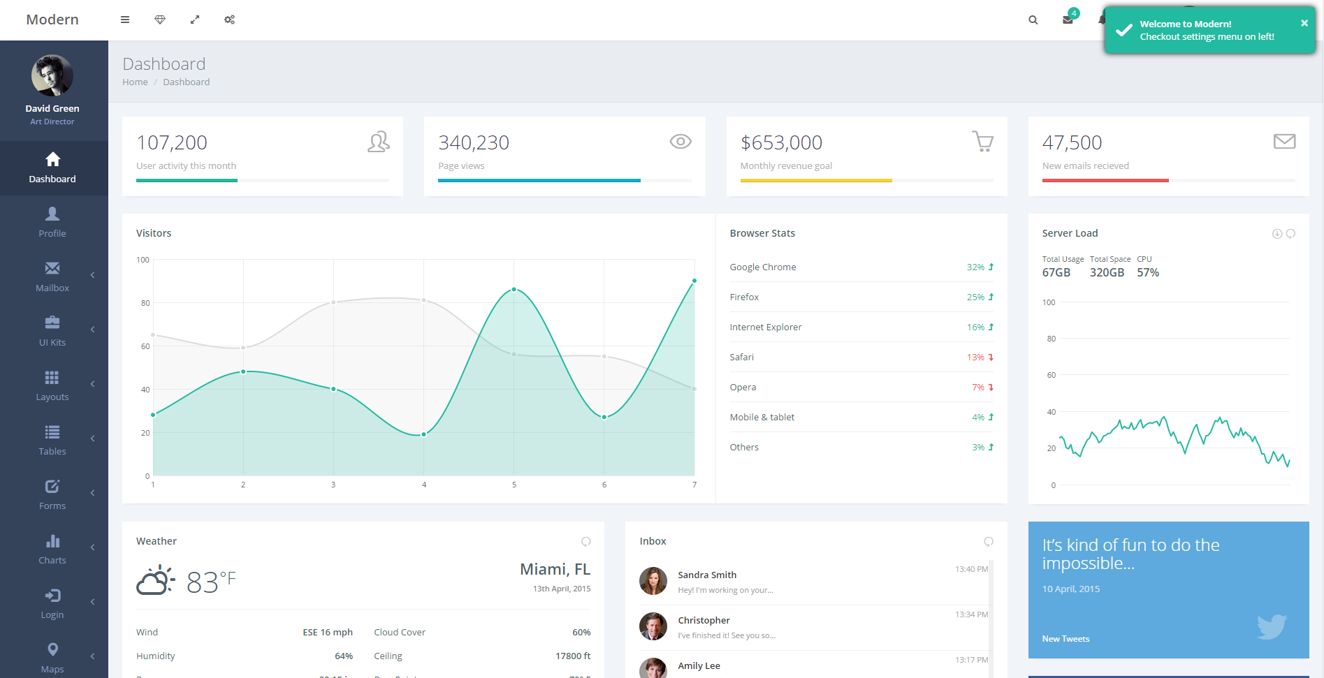
Project step 4: Graphic design or mockup
1
2
3
4
5
6
7
What are my expectations? | Who is responsible? | How can I achieve it? | What can help me? (3° and 4° ingredients tools and technologies)
Having a “graphic line” approved by the customer. | Graphic designer Analyst | Figuring out what your customer likes and what does not. Showing to the customer drafts of the project.
Beginning development | Analyst | Sharing the working progress to my team
Notes:
Obiettivo
Chi lo fa
Strumenti utilizzati
Condivisione

Slide 21
Now 10 seconds of meditation
We have done 4 of 7 steps with no code!
You can start coding once your project is as clear as possible.
Notes:
and each person in the team feels comfortable to communicate.

Slide 22
Now code
is important
It is time for module development

Slide 23
Project step 5: Module development
1
2
3
4
5
6
7
Module is like a piece of Lego
A project needs one or more modules
A module is important we need a good methodology for developing a module.
Notes:
Obiettivo
Chi lo fa
Strumenti utilizzati
Condivisione

Slide 24
Project Step 5: Module development is important!! Go inside
1
2
3
4
5
6
7
For each module in your project
1
2
3
4
5
6
Function analysis
Mockup
Data architecture (database)
Assembly
Prototype html, css, angularJS
Web API
Test
Notes:
designing, creating, deploying and managing an organization's data architectur

Slide 25
Project Step 5: Module development
1
2
3
4
5
6
7
 | What are my expectations? | Who is responsible? | How can I achieve it? | What can help me? (3° and 4° ingredients tools and technologies)
1 | The team understands in detail what we want to develop. | Analyst | Function analysis Wireframe
2 | Prototype for customer (quick demo) | Front-end developer and graphic designer | Prototype using html, css, angularJS
3 | Build tables and stored procedures | Database architect and .net developer | Data architecture (database)
4 | Creating c# classes and algorithms. | .net developer | Web API
5 | Frontend and logic together. | .net and front-end developer | Assembly
6 | Testing and bugfixing | Developers and analyst | Test
Notes:
1. I wireframe e mockup devono rapprese il può possibile le funzionalità e l’aspetto grafico
2. Prototipo show prototipo che può essere mostrato al cliente
3. Creazione tabelle e stored procedure
4. Creazione classi e logica per il recupero e salvataggio dei dati
5. Risolvere i problemi che emergono. Analizzare la qualità del lavoro.
Obiettivo
Chi lo fa
Strumenti utilizzati
Condivisione

Slide 26
Project Step 6: Assembly (all pieces together)
1
2
3
4
5
6
7
What are my expectations? | Who is responsible? | How can I achieve it? | What can help me? (3° and 4° ingredients tools and technologies)
What is working and what is not working…why? | All team | Unit testing
To close project development | All team | Passing test successfully
Notes:
Obiettivo
Chi lo fa
Strumenti utilizzati
Condivisione

Slide 27
Step 7: Test and bug fixing
1
2
3
4
5
6
7
What are my expectations? | Who is responsible? | How can I achieve it? | What can help me? (3° and 4° ingredients tools and technologies)
Verifying that the project is consistent with the expectations of the analysis | Analyst-Project manager | To analyze the quality of work.
We are ready for a demo | Analyst-Project manager | To validate the project closure
Notes:
Obiettivo
Chi lo fa
Strumenti utilizzati
Condivisione
and verifying issues and bugs.

Slide 28
Now we are ready for a demo
Customer satisfaction?
Best user experience interface?
Fast development?
Customer Enterprise applications?
Expectation
90%
Demo with your customer
80-90%
First demo
Customer happiness
With smart
team working approach
Aspettativa progetto al 90% congruo
Con le aspettative.
Checklist
Cosa piace
Cose da migliorare
60%
50-60%
First demo
Customer happiness
No smart
team working approach

Slide 29
Questions?

Slide 30
Thank you
Notes:
Thank you very much for attending

